Slide 1

The Join Warriors
Data Engineering Project
Year 2025
Sagnik, Goutham, Muhid, Aswathy, Pranjaly

Slide 2
Roles
Aswathy Marottikkal Ramesh & Muhid Abid Siddiqui - Data Pipeline Plumbers
Data streaming
Data cleaning and processing
Pranjaly Paul - Analytics Wizard
Dashboard visualizations
Dashboard integration with other modules
Goutham Muralikrishnan & Sagnik Das - Architects of Organized Data Chaos
Database management
Query design
Everything else

Slide 3
Table of contents
01
02
03
04
Dataset
Analysis Plan
Architecture
Reference

Slide 4

01
Dataset

Slide 5
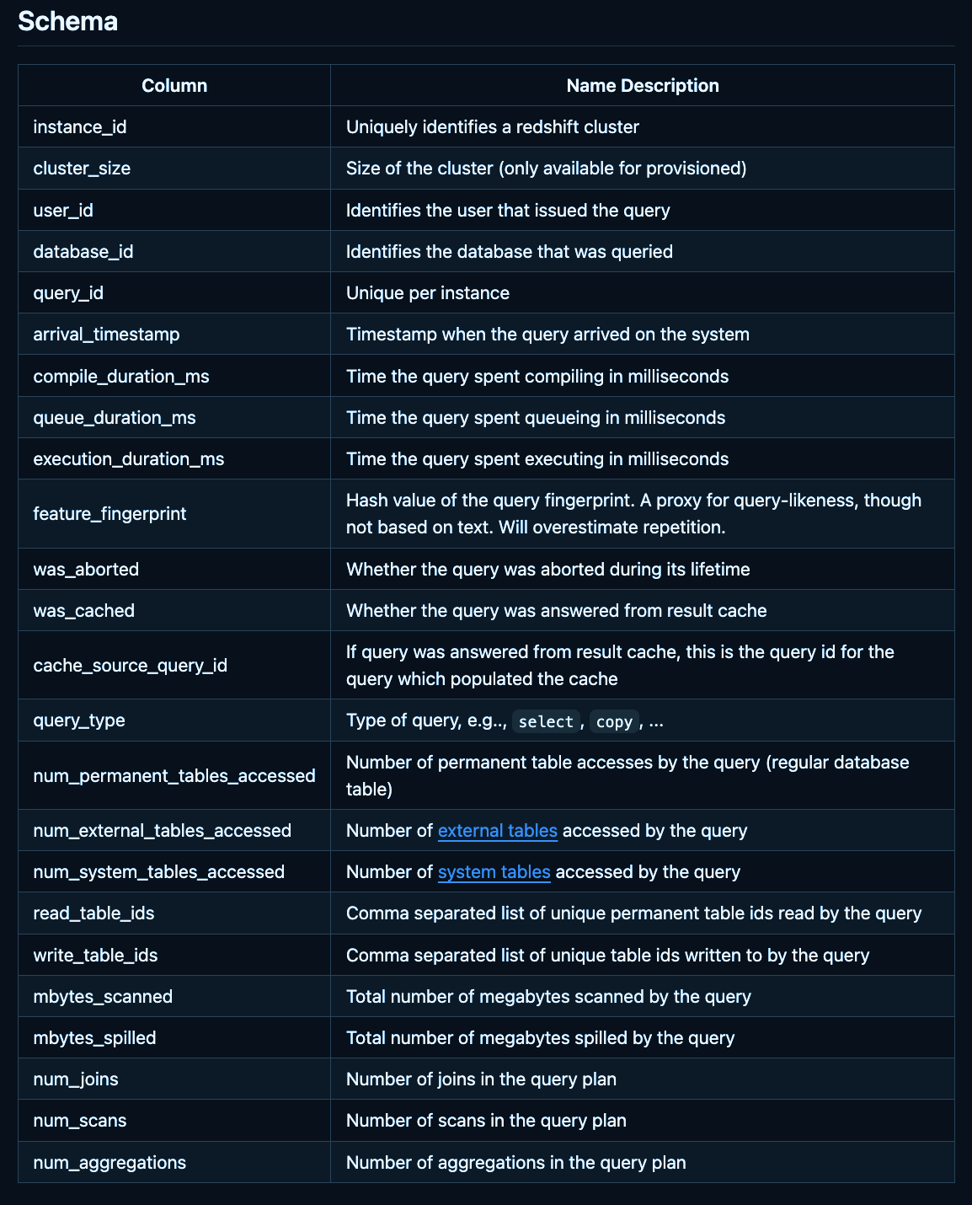
Redset
The Redset dataset contains three months of user query metadata from a selected sample of Amazon Redshift instances. It includes data for 200 provisioned and serverless instances each.
The dataset is not representative of the entire Redshift fleet but provides biased sample data to support the development of new benchmarks and exploration of machine learning techniques for workload forecasting.
The dataset includes various metadata fields such as instance ID, user ID, query ID, timestamps, and performance metrics like compile duration, queue duration, execution duration, and more.[5]

Slide 6
02
Analysis Plan

Slide 7
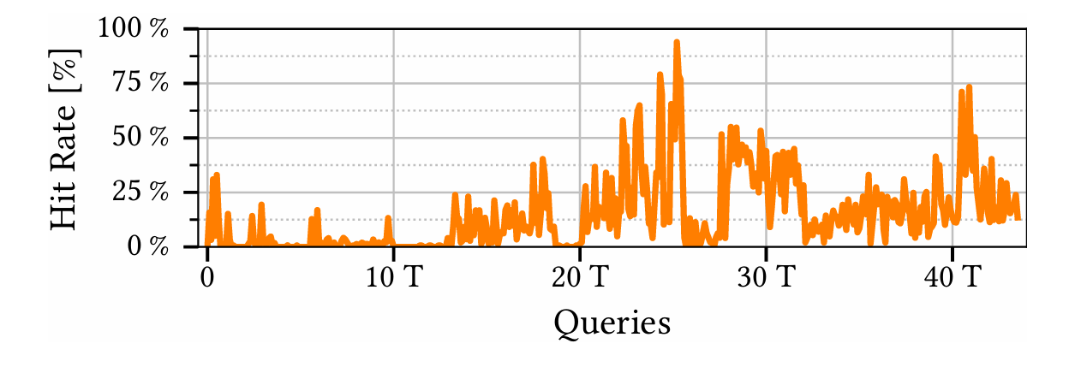
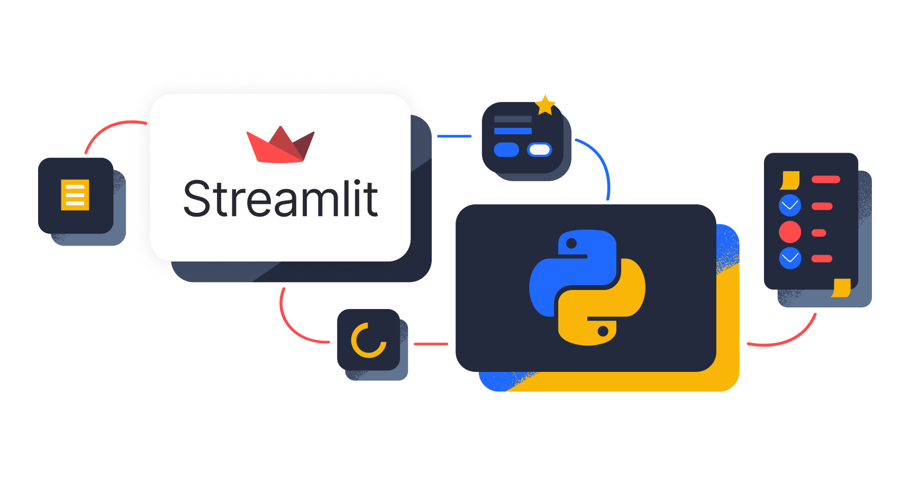
Questions we solve
• Designed a Streamlit-powered data pipeline and live dashboard to integrate streaming and historical query logs from the Redset dataset for Amazon Redshift optimization.
• Key metrics visualized on the dashboard include:
Real-time histogram of the top-k most accessed tables and showing the percentage of queries they appear in.
Plot Hit rate of the result cache, similar to the Fig. 13 from the Predicate Cache paper[1].
Analysis of the correlation between compile time and number of joins in SELECT queries, determining whether the relationship is linear, quadratic, or exponential.

Slide 8
03
Architecture

Slide 9
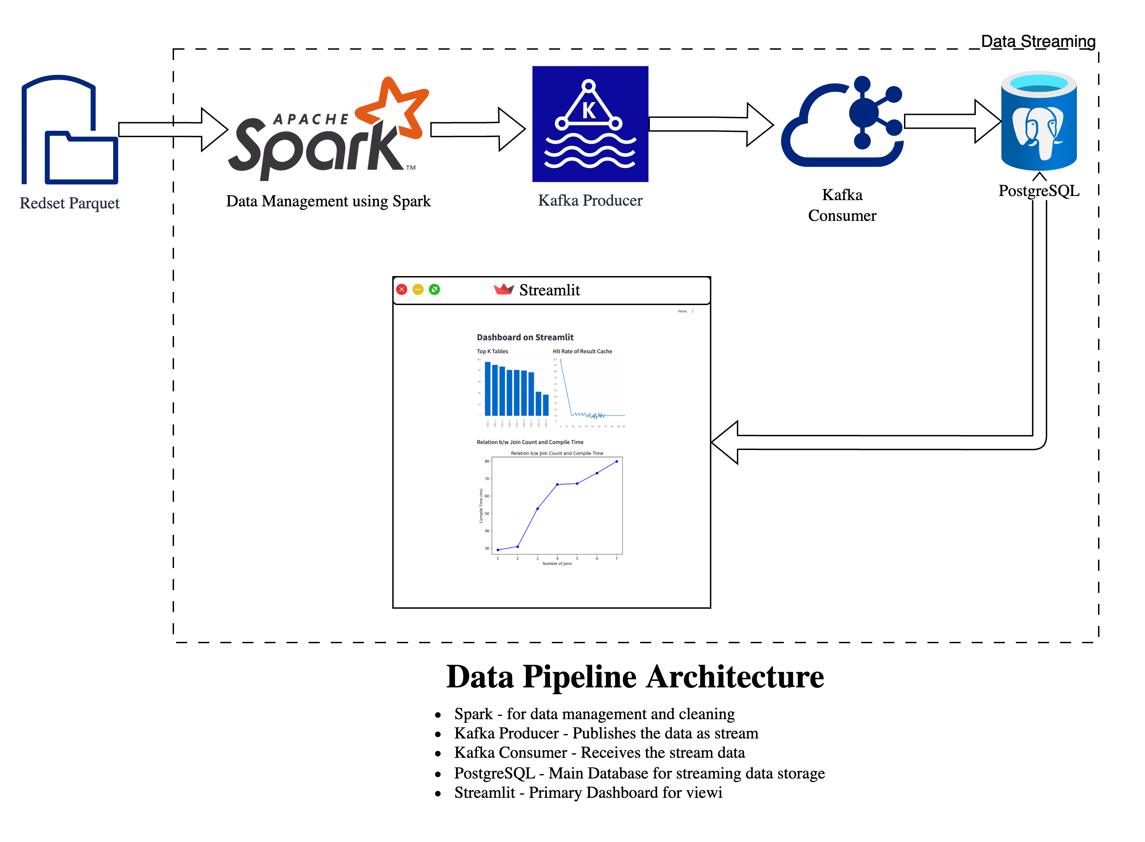

Slide 10
04
References

Slide 11
01
Predicate Cache
T. Schmidt, A. Kipf, D. Horn, G. Saxena, and T. Kraska, "Predicate Caching: Query-Driven Secondary Indexing for Cloud Data Warehouses," presented at Amazon Web Services, Palo Alto, CA, USA.
02
PostgreSQL Documentation
"PostgreSQL 15 Documentation," PostgreSQL Global Development Group, Oct. 2023. [Online]. Available: https://www.postgresql.org/docs/15/. [Accessed: Jan. 27, 2025].
03
Kafka
Documentation
"Apache Kafka Documentation," The Apache Software Foundation, 2025. [Online]. Available: https://kafka.apache.org/documentation/. [Accessed: Jan. 27, 2025].
04
Streamlit
Documentation
"Streamlit Documentation," Streamlit Inc., 2025. [Online]. Available: https://docs.streamlit.io/. [Accessed: Jan. 27, 2025].
05
Github repository
GitHub. (2025). amazon-science/redset: [online] Available at: https://github.com/amazon-science/redset?tab=readme-ov-file [Accessed 27 Jan. 2025].

Slide 12
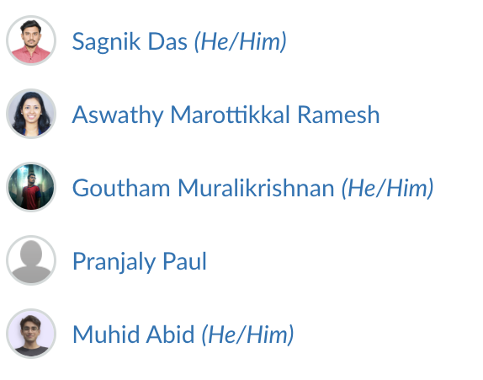
Thanks!
Do you have any questions?
Contact us via Canvas:

